Slide 1
Linear Algebra
线性代数
Zongbin Chen YMSC, Tsinghua University
陈宗彬 清华大学数学科学中心
Email: zbchen@tsinghua.edu.can

Slide 2

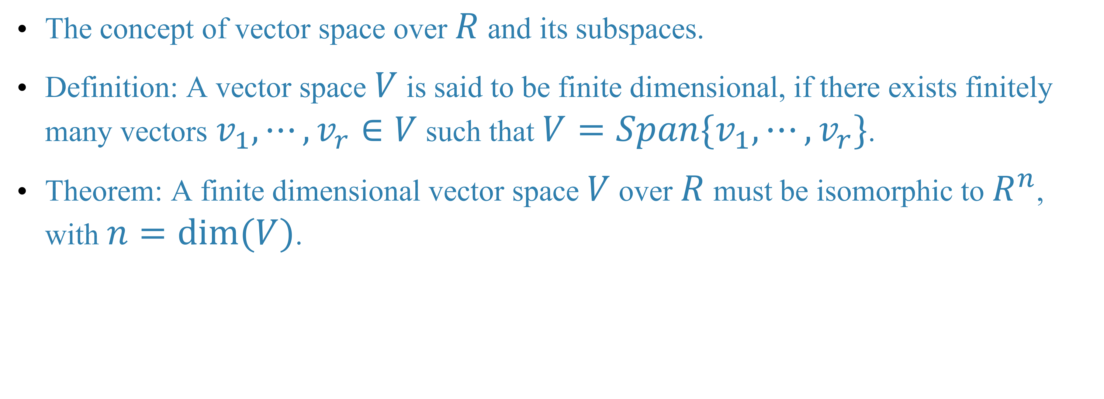

Quick review
Finite dimensional vector space
The concept of vector space over $R$ and its subspaces.
Definition: A vector space $V$ is said to be finite dimensional, if there exists finitely many vectors $v_{1},⋯,v_{r}∈V$ such that $V=Span\{v_{1},⋯,v_{r}\}$.
Theorem: A finite dimensional vector space $V$ over $R$ must be isomorphic to $R^{n}$, with $n=dim(V)$.

Slide 3
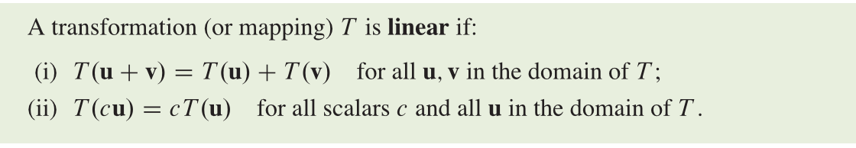

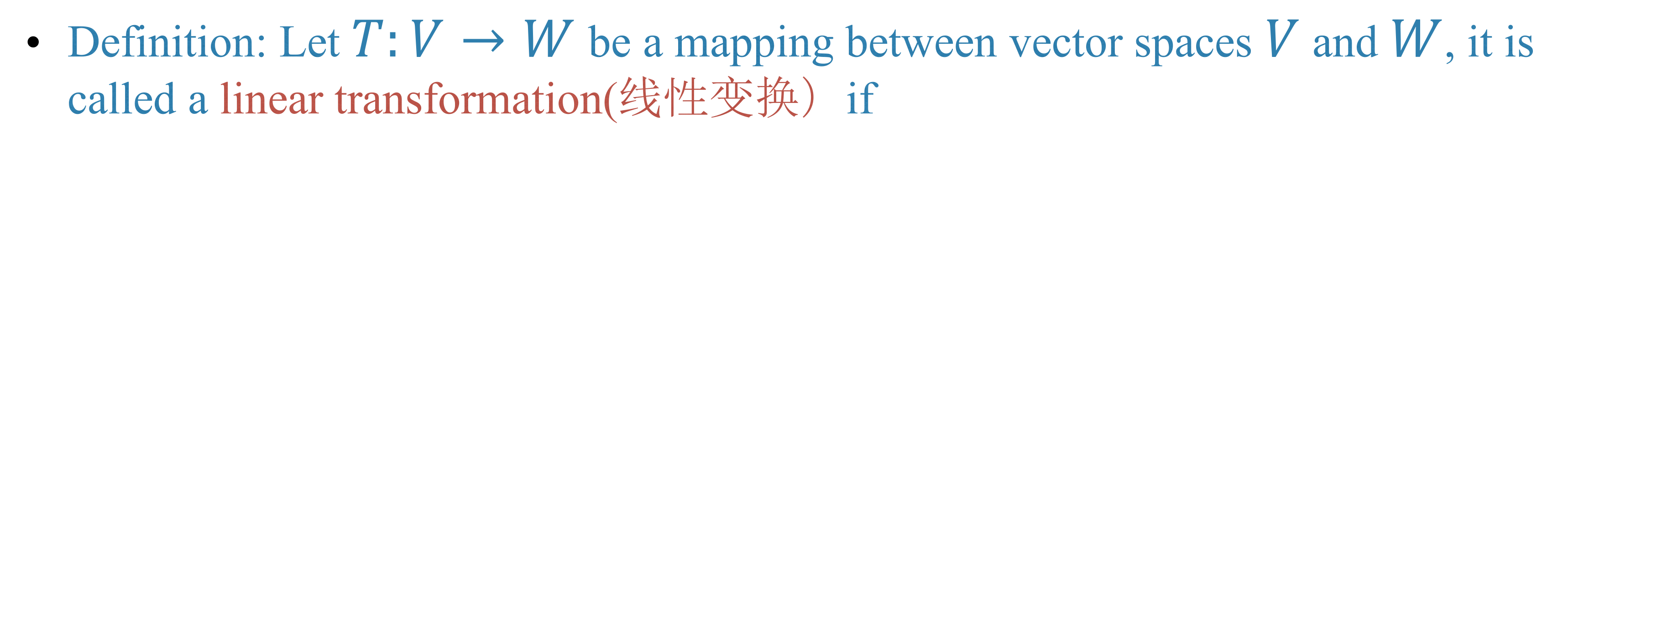
Linear transformation
Definition: Let $T:V→W$ be a mapping between vector spaces $V$ and $W$, it is called a linear transformation(线性变换）if

Slide 4
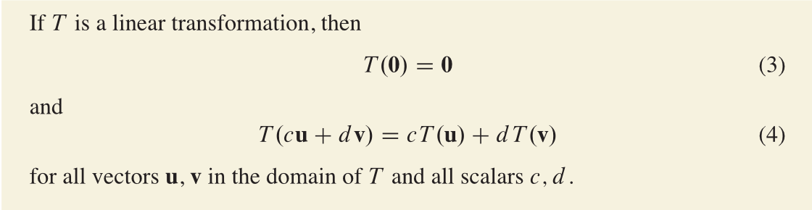
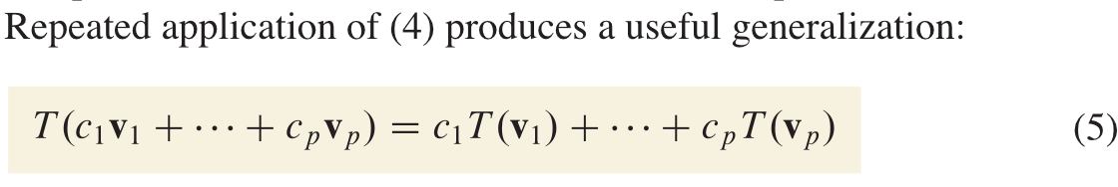
Basic properties
The physicists call it the superposition principle(叠加原理).

Slide 5
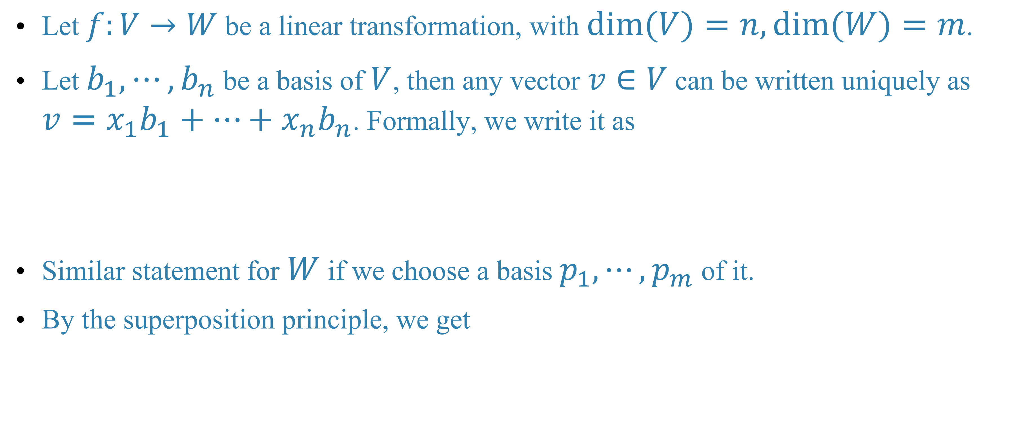
The matrix of a linear transformation
Let $f:V→W$ be a linear transformation, with $dim(V)=n,dim(W)=m$.
Let $b_{1},⋯,b_{n}$ be a basis of $V$, then any vector $v∈V$ can be written uniquely as $v=x_{1}b_{1}+⋯+x_{n}b_{n}$. Formally, we write it as
Similar statement for $W$ if we choose a basis $p_{1},⋯,p_{m}$ of it.
By the superposition principle, we get

Slide 6
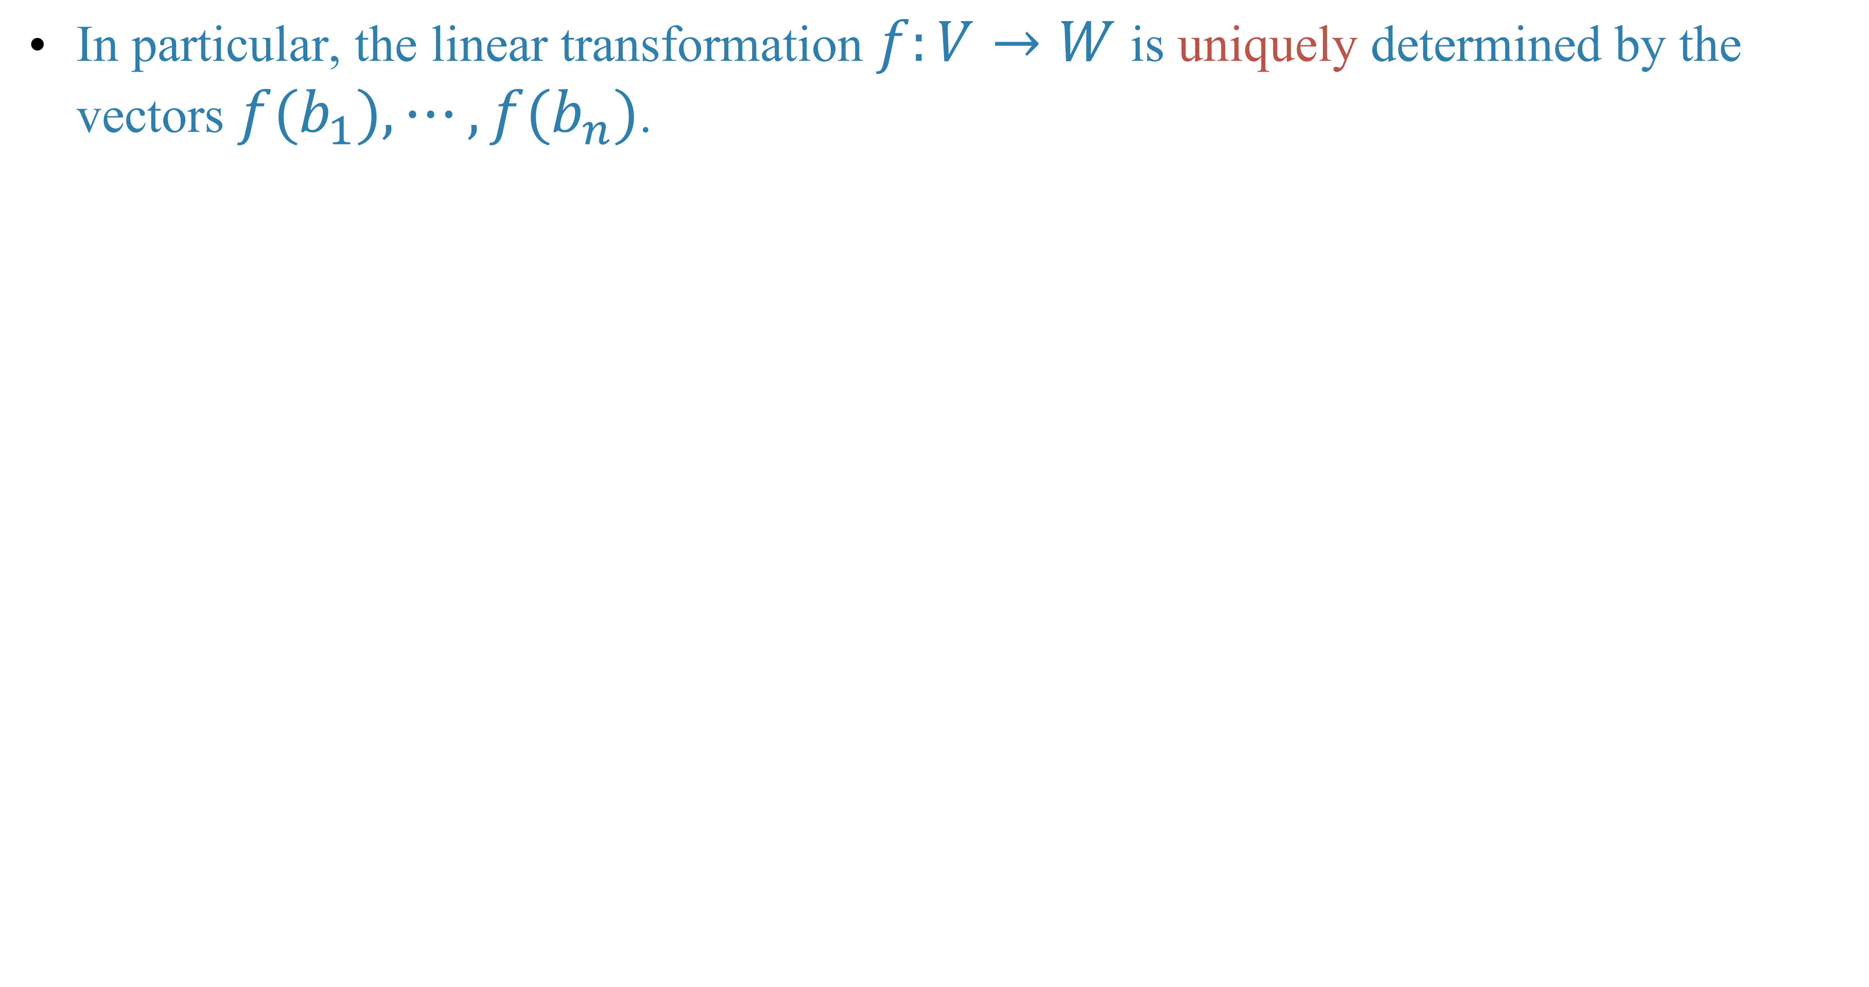
In particular, the linear transformation $f:V→W$ is uniquely determined by the vectors $f(b_{1}),⋯,f(b_{n})$.

Slide 9
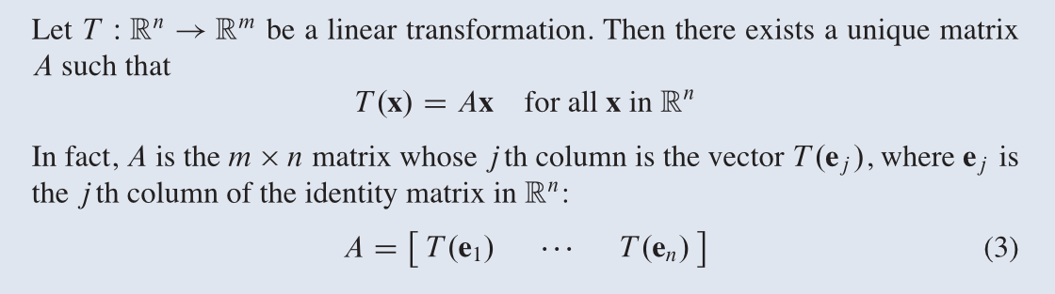
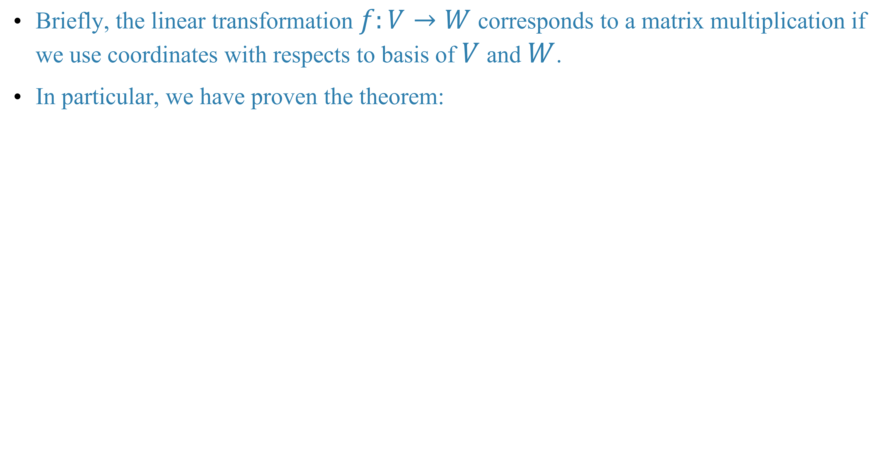
Briefly, the linear transformation $f:V→W$ corresponds to a matrix multiplication if we use coordinates with respects to basis of $V$ and $W$.
In particular, we have proven the theorem:

Slide 10
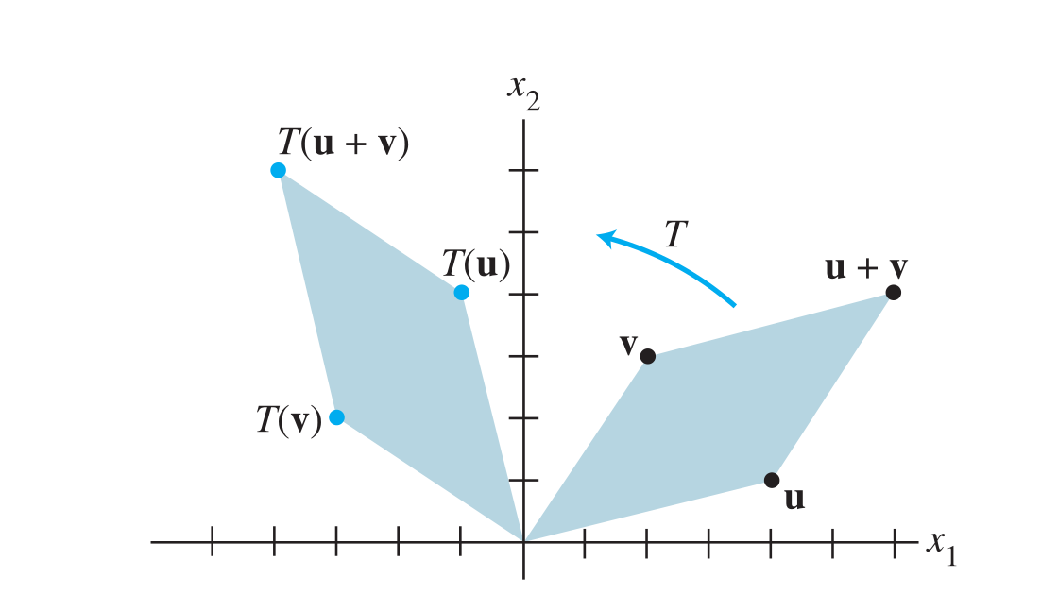
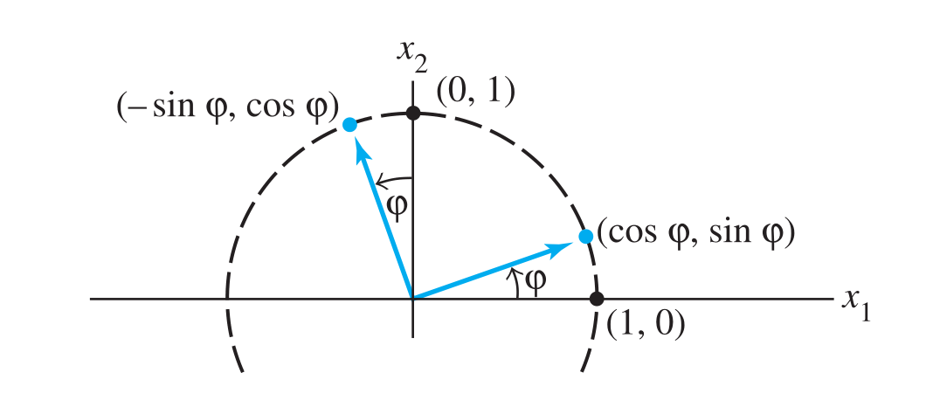
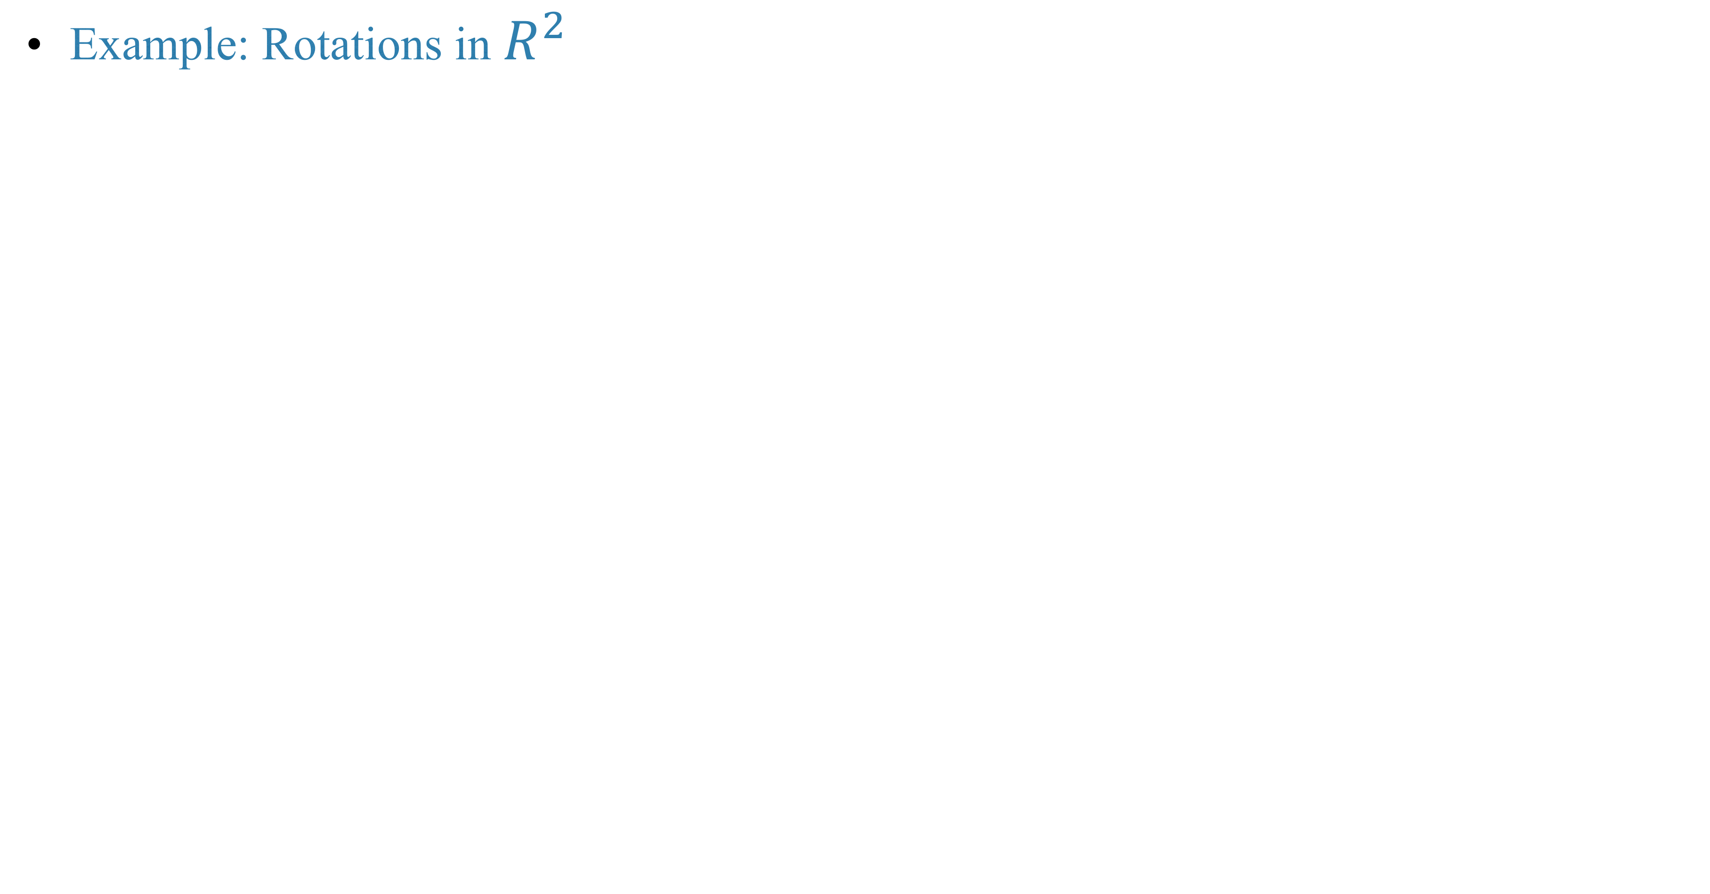
Example: Rotations in $R^{2}$

Slide 12
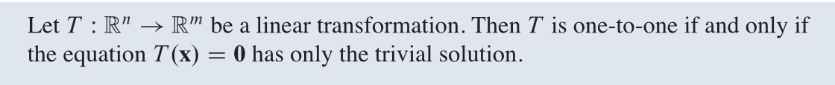
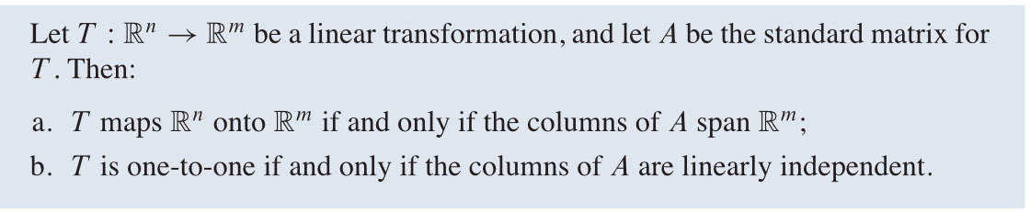
Theorem
Theorem

Slide 13
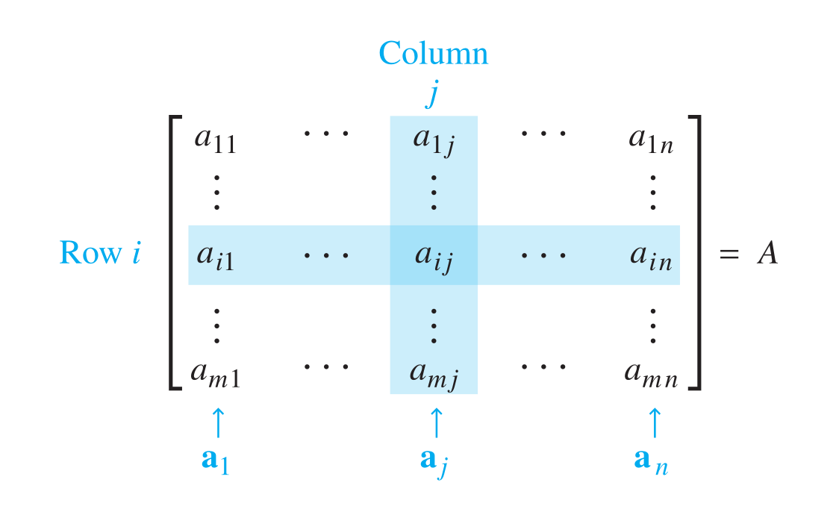
Matrix operations
Notations

Slide 14
Sum and scalar multiples of matrix

Slide 17
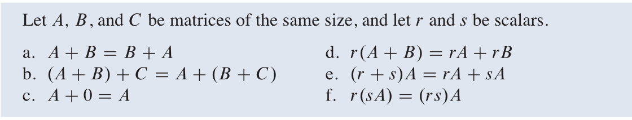
Theorem

Slide 18
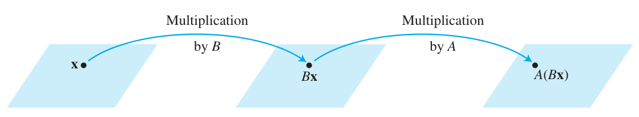
Composition of linear transformation and matrix multiplication

Slide 21
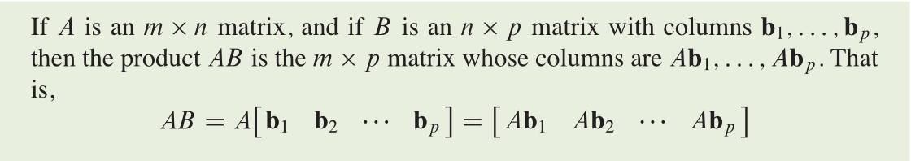
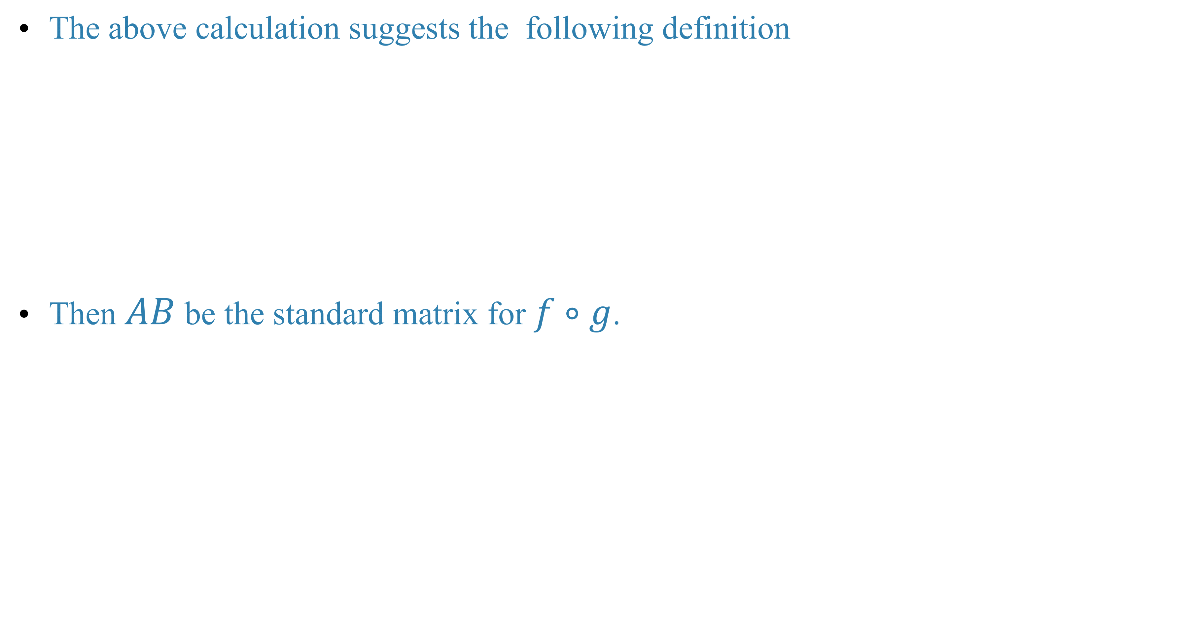
The above calculation suggests the following definition
Then $AB$ be the standard matrix for $f∘g$.

Slide 22
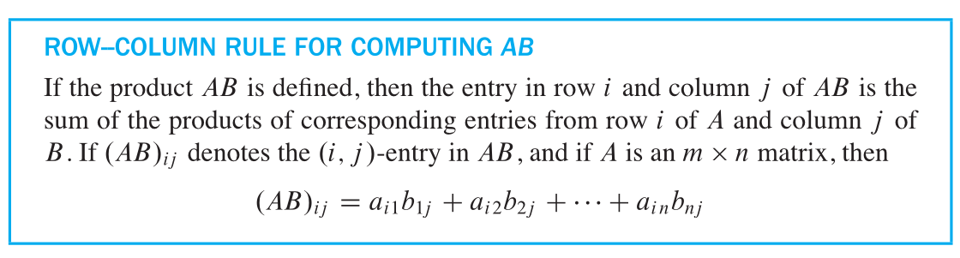
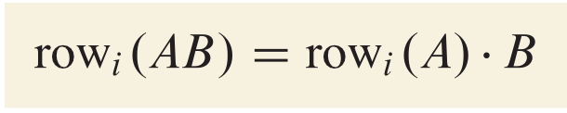
Notice also that

Slide 23
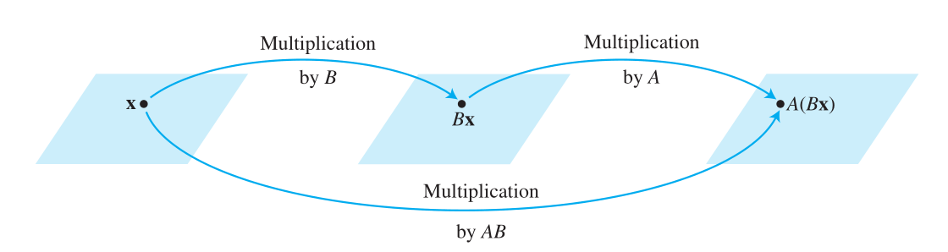
Summary

Slide 24
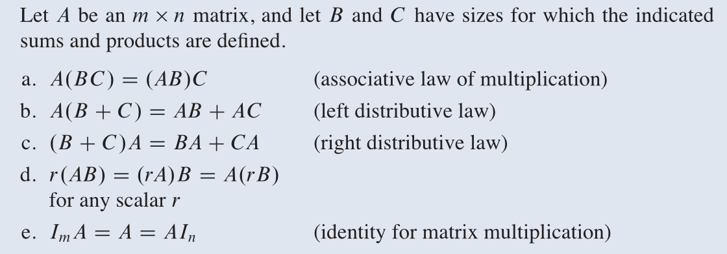
Properties of matrix multiplication

Slide 26
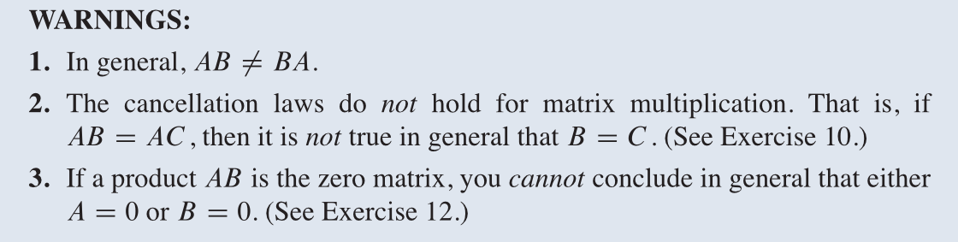
Example

Slide 28
Transposition(转置) of a matrix

Slide 29
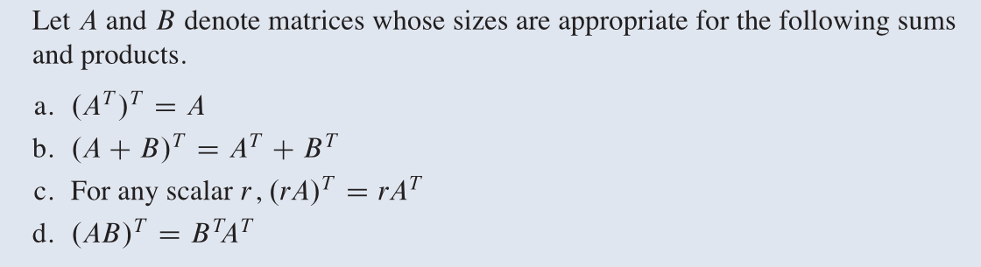

Slide 30
Homework
Lay-Lay-McDonald, chapter 2, 2.1 exercises, question 11, 22, 23, 25.

Slide 31
Next time
Lay-Lay-McDonald, chapter 2, 2.2.

